Slide 1
Creating work samples
The Role of Observation and Assessment

Slide 2
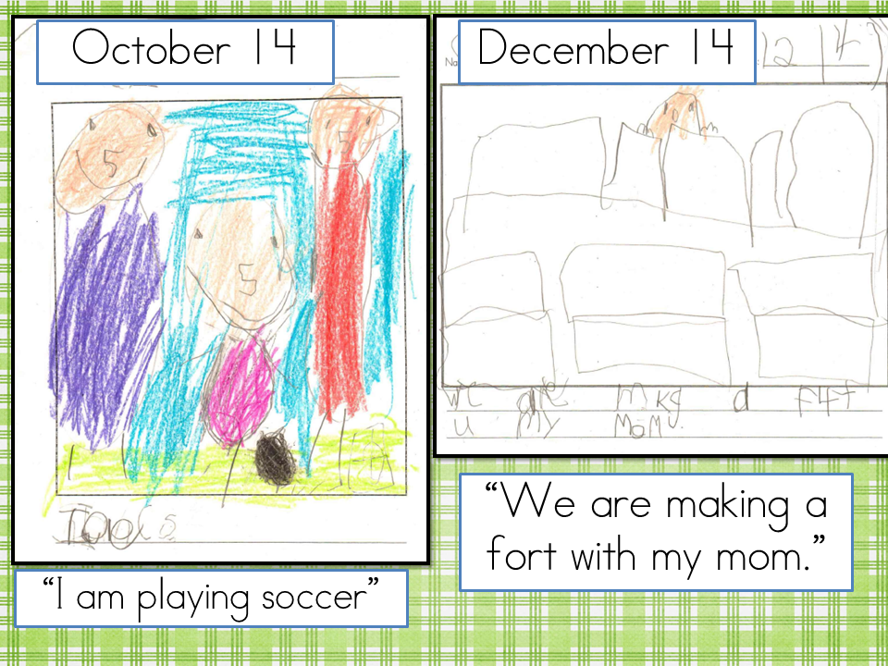
What is a work sample?
Work samples include:
Drawings
Paintings
Cutting
Writing
Journals
Dictated stories
Computer work
etc…

Slide 3
Purpose of a Work Sample
Powerful form of authentic assessment
Tangible evidence of child’s learning
Fuller understanding of what a child knows and can do
Communicates to teachers in program and parents
Can influence teaching
Can go with the child to future school or home

Slide 4
Work Sample Goals
Organization – by date and/or by developmental goals
Collect certain items at the same time from all children (drawing from first week of school and last week of school).
Collect on a regular basis – label, date, and annotate work samples before storing them.
Samples reflect developmental goals for children.
Annotated work samples should include: Child’s name and date, the setting or context of activity, a written description explaining what happened.

Slide 5
Work Sample Ideas
Have children select examples of a favorite or “best” work to include in their portfolio.
Collect evidence of a child’s ability in a specific skill –
drawing, social interactions (photo or anecdotal observation), written language sample, photo of block building, writing sample).

Slide 6
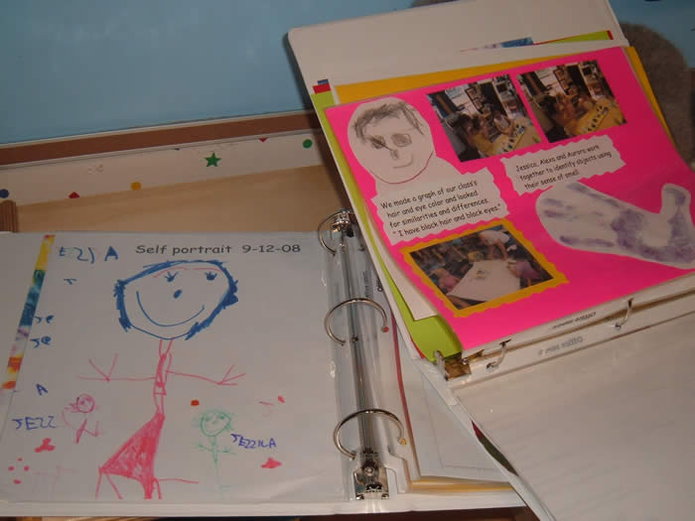
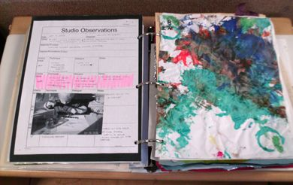

Slide 7
